Slide 1


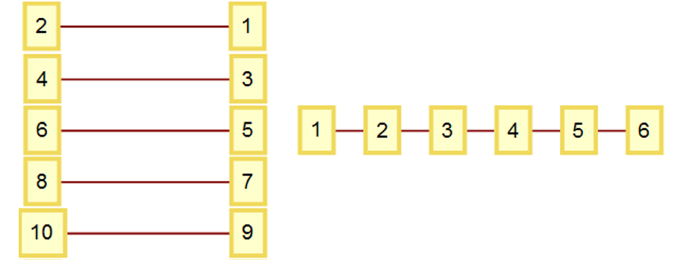
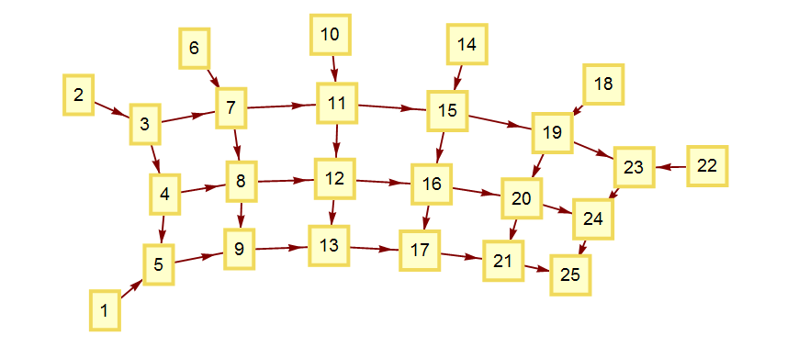
Identifying Networks
Mathematically!
Check whether it’s new or not
Jeanna Toulouse
W19
Christofer Trana
W19
Any 1-d network “summarized” compactly:
Another example:
Network | {1→2, 3→4, 5→6, 7→8, …} | {1→2, 2→3, 3→4, 5→6, …}
List of Link Length Sets | {{1},{},{1},{},{1},{},{1}, {},{1},{},…} | {{1},{1},{1},{1},{1},…}
Summary | {{1},{}} | {{1}}
Network | {{1→5, 2→3, 3→4, 3→7, 4→5, 4→8, 5→9, 6→7, 7→8, 7→11, 8→9, 8→12, 9→13, 10→11, 11→12, 11→15, 12→13, 12→16, 13→17, 14→15, 15→16, 15→19, 16→17, 16→20, 17→21, 18→19, 19→20, 19→23, 20→21, 20→24, 21→25, 22→23, 23→24, 24→25}}
List of Link Length Sets | {{4}, {1}, {1,4}, {1,4}, {4}, {1}, {1,4}, {1,4}, {4}, {1}, {1,4}, {1, 4}, {4}, {1}, {1,4}, {1,4}, {4}, {1}, {1,4}, {1,4}, {4}, {1}, {1}, {1}}
Summary | {{4}, {1}, {1,4}, {1,4}}

